Slide 1
Multimodal Depression Detection and Severity Estimation
Achyut Shukla
Aparna Anand
Avik Basu
Indhu Kamala Kumar
Madhusudhan Krishnamachari

Slide 2

Introduction
Mental disorder that affects daily life.
Leads to fatigue, insomnia, weight loss, weight gain, etc.
350 million+ people affected by depression
Hence, diagnosis and treatment of depression is important.

Slide 3
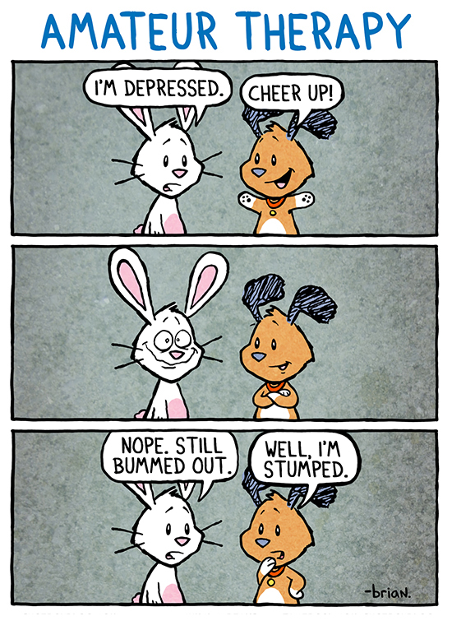
Are doctor examinations accurate?
Classical approach to identify depression – interview, questionnaires.
Not reliable – patients might not provide accurate information.
Constrained – Patients can’t express themselves fully.
Patients not comfortable during dyadic interviews.

Slide 4
Can machines detect depression?
Yes they can! – Machine Learning + AI problem.
Lots of work done by USC – DeVault et al, Ghosh et al, Scherer et al, Yu et al.
Identify behavioral cues that indicate depression.
These cues are primarily visual and acoustic.

Slide 5
How to make patients comfortable?
Fear – Doctors will view patients negatively.
Impression management – Humans want doctors to view them positively.
Lucas et al found that patients disclose honestly to Virtual Humans.
‘Safe’ environment - VHs don’t judge patients.

Slide 6
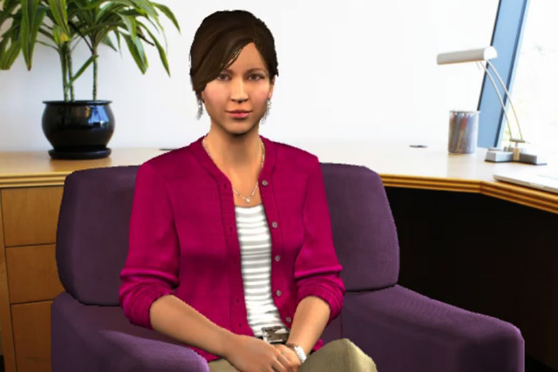
Distress Analysis Interview Corpus-WoZ
Corpus of audio/video recordings of patient interviews by USC ICT.
Virtual Human Ellie controlled by two humans
Interviews have Q&A nature.
Analyze these interviews – detect depression.
Each video has:
PHQ Binary Labels – Depressed/non-depressed
PHQ scores – severity of depression
Virtual Human ELLIE
Photograph: Teresa Dey/USC ICT
Notes:
For depression detection and severity estimation we are using Distress analysis Interview Corpus provided by USC ICT.
Distress analysis interview corpus consists of interviews conducted by humans, conducted by virtual human ellie controlled by two humans as well as interviews conducted by autonomous virtual agent.
Interviews conducted by ellie controlled by two humans has the most accurate feature set and has been used in most of prior work for depression detection.
Interviews in Wizard of Oz dataset consists of a questions and answers, where ellie is asking the interviee a set of questions. For each video in the dataset we are having PHQ binary labels which provide us information about whether person is depressed or not as well as PHQ scores which give us serverity of depression.

Slide 7
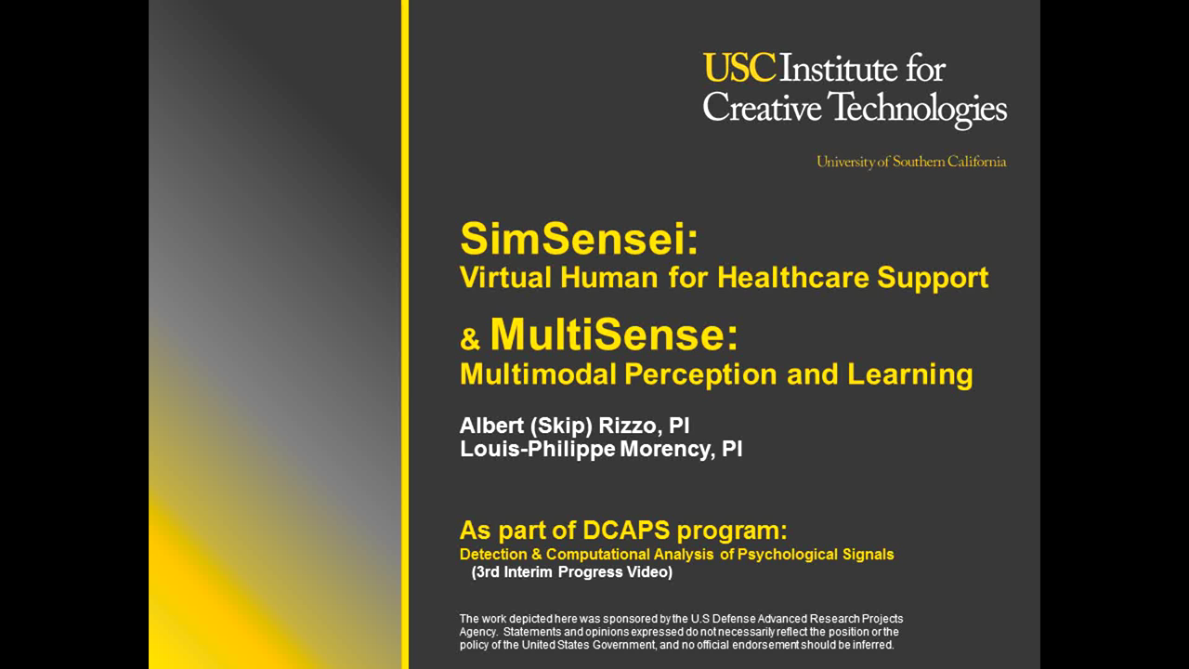

Slide 8
Prior Work
Yu et al represented the transcript as question-answer pairs.
Ghosh et al proposed a tri-modal approach which improved prediction
Questions in 3 categories: Intimate-Positive, Intimate-Negative, Non-intimate
Context-based classifier – Used simple Max Entropy model
Can we be more specific? We use only intimate questions
Notes:
Prior to Ghosh et al, all approaches were bi-modal.
Ghosh explored the effect of verbal and non-verbal cues, as well as contextual information (responses to questions)
We feel intimate questions have more information and hence, we explore only those questions.
We also propose an enhanced classifier for this project.

Slide 9
Question Extraction and Annotation
Questions paired with responses play an important role.
We split intimate questions using two ways:
Discriminative/Non-discriminative
Positive/Negative
Used only top 27 questions by frequency.
Notes:
Question Selection:
As achyut mentioned, we are going to use q answer pairs.
We used only intimate question since it would trigger responses which could help us identify a depressed person from a non depressed person where as the responses to the non intimate questions might not add any value.
Also we consider frequent questions since it would be common among the subjects and would get us more data points.
We identified 27 such questions.
We are not considering non-intimate infrequent questions
we categorized the questions using two ways:
positive/negative
Discriminative/non discriminative

Slide 10
Question Categorization
“What are you most proud of in your life?” – Positive
“Is there anything you regret?” – Negative
“How have you been feeling lately?” – Discriminative
“How would your best friend describe you?” – Non-discriminative
Notes:
Questions which set a positive polarity were considered positive. For eg, what are you most proud of in your life. This clearly is a positive question and questions that set negative sentiment were considered negative. Like, “is there anything you regret”
The second approach is discriminative/ non discriminative:
Responses from depressed and non-depressed people can be distinguished easily for discriminative questions. For eg, for “how have you been feeling lately”?, we can expect a depressed person to answer more negatively. Where as for responses for non discriminative questions can’t be easily distinguished. We Can’t clearly say whether the response is coming from a depressed or non-depressed person
We annotated each question into pn and dnd . Took a majority voting and we got a good inter rater agreement.
We ran our classifiers with both ways of categorization and found that positive-negative categorization does better, which we’ll see later. So for simplicity, while explaining we’ll use the positive-negative categorization only.

Slide 11
Feature Extraction
Acoustic – FORMANT, COVAREP
Visual – FACET, CLM (HoG, Pose, Gaze, 2D, 3D)
Linguistic – LIWC (Word-level features)
Types of utterances by Ellie:
Intimate question
Non-intimate question
Follow-up question
Acknowledgement
How are the features extracted?
Notes:
We use a tri modal approach. i.e we consider acoustic, visual and linguistic features.
Acoustic features consist of COVAREP and FORMANT which includes vuv, f, energy etc
Visual features consist of FACET and different CLM files and covers face 2d,3d points, height, width, pose,gaze, had rotation etc
Linguistic features are from LIWC and includes occurrence of words, adjectives, emotions(happy,sad), etc
Types of utterances:
How are the features extracted??
For each participant, we look at the transcript to find one frequent intimate questions. We start accumulating the responses using start and end time till we find another frequent intimate or non intimate questions.

Slide 12
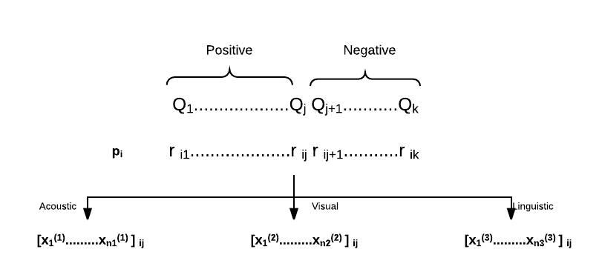
Notes:
At this point, we have the question categorizations and the extracted responses of the participants. For each participant, we take all the responses to positive questions together (lets call them positive responses) and those of negative questions together (lets call them negative responses). Each response is made up of three feature vectors, acoustic, visual and linguistic. We separate each response in this manner.
For each participant, we have a set of acoustic vectors, a set of visual vectors and a set of linguistic vectors for the positive responses. Similarly for the negative responses. Therefore, for each participant, we have extracted features of 3 modes for each of the 2 categories and thus end up with 6 feature matrices.

Slide 13
Feature Selection
Three major methods:
Removing low variance
L1 Norm
Select K best – ANOVA
Pipelined
Reduce to 20 features initially
Notes:
The feature selection was different for each category per mode. So six feature selection processes.

Slide 14
Data Preparation
Data Split:
Train: 107 videos
Test: 47 videos
Dev: 35 videos
15-18 Q&A pairs per video.
Late Fusion approach

Slide 15
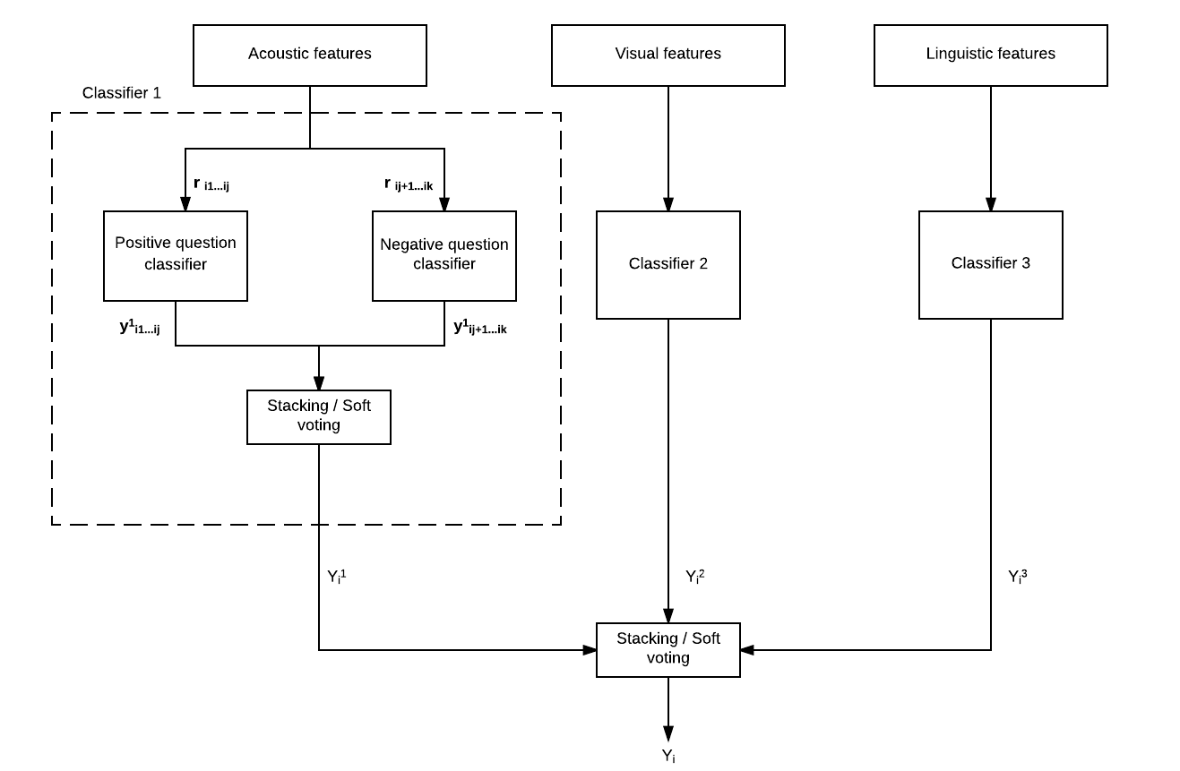
Notes:
Each response is a data point
Why average of y’s
Why different weights for different modes
Combine all the Ys using a soft voting approach
Soft voting returns the argmax of the predicted probabilities.
Training is performed by fitting the feature matrices to all the classifiers

Slide 16
Predicting depression
Individual probability estimates for each response r_{ij} is obtained.
Average over probability estimates.
Each category (P/N, D/ND) is weighted unequally.
Combine estimates from both categories using Soft Voting – Get Binary Label (Depressed/Not Depressed)

Slide 17
Initial Results
Discriminative/Non-discriminative
Positive/Negative
Acoustic
Visual
Linguistic
Acoustic
Visual
Linguistic
0.50
0.55
0.44
0.53
0.62
0.44
0.4
0.4
0.5
0.1
0.4
0.2
0.55
0.67
Notes:
These are F-1 scores.

Slide 18
Work in progress
Find best combination of classifiers
Better Tuning of Hyperparameters
Depression Severity Estimation – Regression Problem
Notes:
We are currently using Logistic regression for depression detection. We are also exploring other classifiers like naïve bayes, svm and random forest for depression detection. Currently we are using 20 features for our classifier we plan to test each of features more and reduce the feature set further as well tune the hyper parameters.
We are also working on measurement of depression severity PHQ score using regression for our model.

Slide 19
Challenges
Skewed Data – Not enough depressed instances
Not every response has verbal features – LIWC captures only certain parts of responses
Missing feature values for many frames

